Slide 1
Word List: cede, ceed, cess
go; yield

Slide 2
What are the roots that mean to go or to yield?

Slide 3
the roots cede, ceed, and cess.

Slide 4
What is the word that means that you keep on going with something or you go ahead with plans?

Slide 5
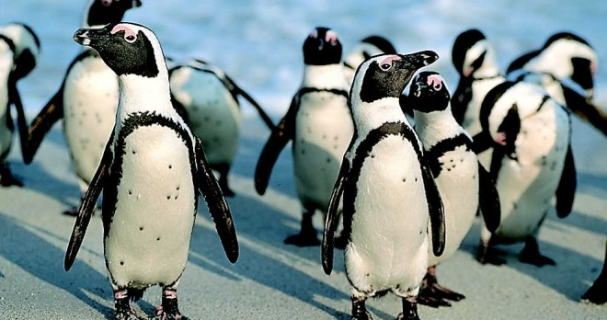
proceed
to keep on going; to go ahead with something; to move along

Slide 6
What is the word that means that you give in and admit that you have lost?

Slide 7
concede
to yield to an opponent that one has lost; to give in; to admit that something is true and valid

Slide 8
What is the word that describes something that someone might wear that goes with the rest of the outfit that person is wearing?

Slide 9
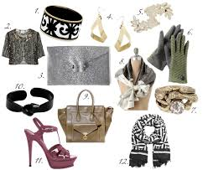
accessory
an article or item worn with an outfit that “goes with” or matches the outfit

Slide 10
What is the word that describes what you do when you do more than is expected or go beyond the minimum?

Slide 11
exceed
to go or be beyond the limit or expectations

Slide 12
What is the word that identifies the person who goes after someone else in a job?

Slide 13
successor
a person who goes after someone else (usually related to a person taking over a job that is of higher rank)

Slide 14
What is the word that describes what you do when you help two people get along and settle their differences?

Slide 15
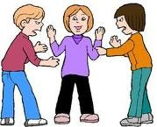
intercede
to mediate; to go between people to help them reach an agreement

Slide 16
What is the word that names the time when children go out and take a break, which usually involves a snack and play time?

Slide 17
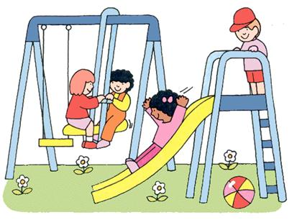
recess
the time during which people go out to take a break

Slide 18
What is the word that describes what happens when something moves backward?

Slide 19
recede
to go or move back

Slide 20
What is the word that describes something that allows people to enter?

Slide 21
accessible
able to go in to, enter, or approach

Slide 22
What is the word that describes what something does when it goes before something else?

Slide 23
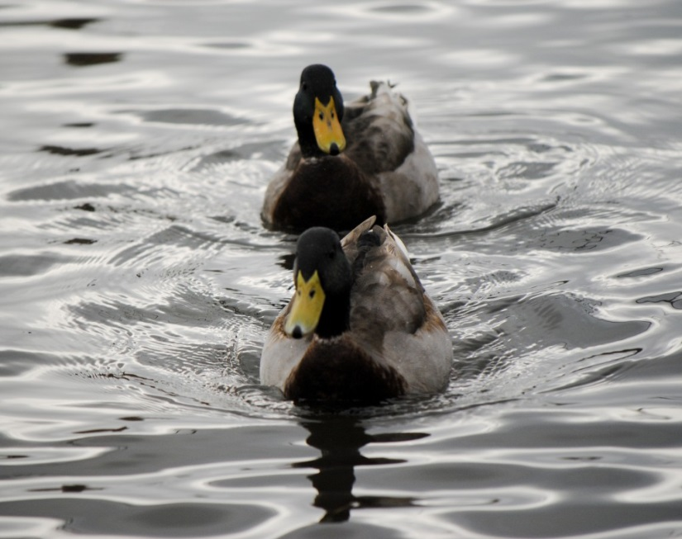
precede
to go before something else in time, order, place, or rank

